Slide 1
Assay in OBI
Tracker:
http://sourceforge.net/p/obi/obi-terms/681/
OBI (SVN Revision: 3814)
631 assays
452 assays have IEDB alternative labels
Most of assay terms were created using assay design pattern and contain following components:
input material
output information content
device used in an assay
objective of assay
main processes of an assay
evaluant role inheres in input material
analyte role inheres in input material for an analyte assay

Slide 2
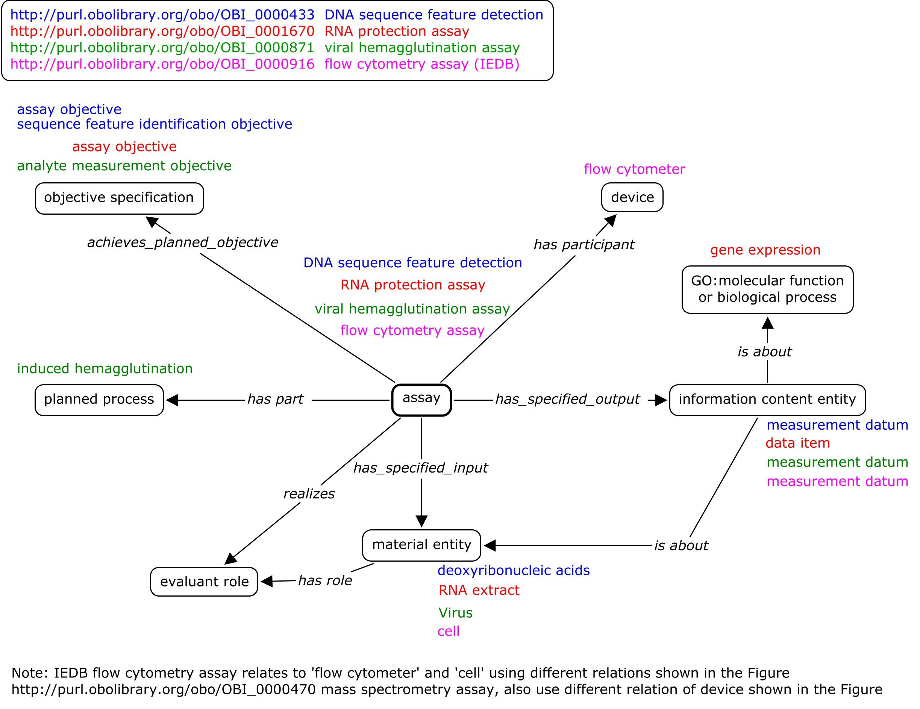
Examples

Slide 3
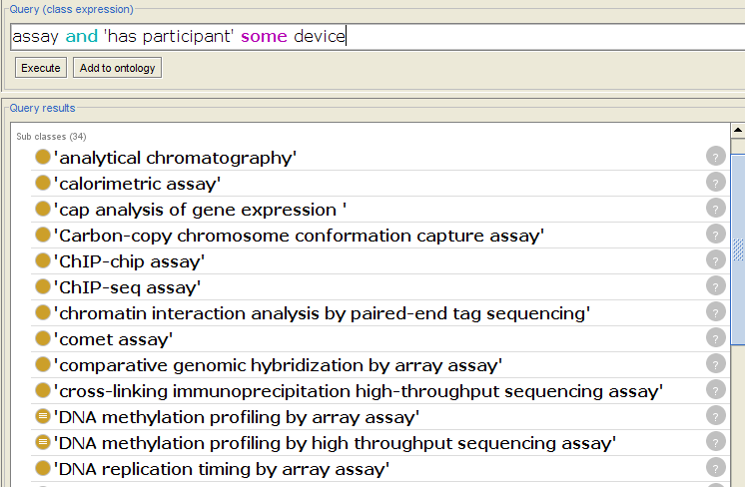
Specify Device Used in an Assay OWL implementation (1)

Slide 4
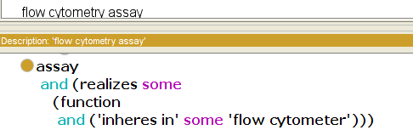
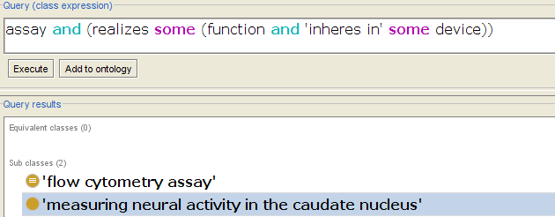
Specify Device Used in an Assay OWL implementation (2)

Slide 5
Applications
microarray assay (by device)
assay and has_participant some microarray
Link to ECO: genomic microarray evidence
DNA assay (by evaluant)
assay and has_specified_input (some and have_role some ‘evaluant role’)
Transcription profiling assay (objective or output)
‘data item’ and is_about GO:gene expression
‘transcription profiling identification objective’
main steps of an assay
PCR assay: has_part some PCR
MAGE-Tab files, array assay, labeling, hybridization

